Slide 1

SUPER SHOP MANAGEMENT SYSTEM
OPERATING SYSTEM LAB
- CSE 310

Slide 2

Presented By
Presented To
Name : Raysha Rahman
Roll : 221002533
Section : D25
Muhaimen Khan
Lecturer,
Dept of CSE,
Green University of Bangladesh

Slide 3
Index
Overview
Features
Working Process
Live Demo
Future Goal
Conclusion

Slide 4
1
Overview
The Super Shop Management System is designed to handle basic operations for a retail shop, including inventory management, sales tracking, and reporting. It provides a text-based interface for shopkeepers to manage products, process sales, and generate simple reports.

Slide 5
2
Features
User Authentication
Inventory Management
Product Sales
Product Management
Multiple Product Option
Intuitive GUI

Slide 6
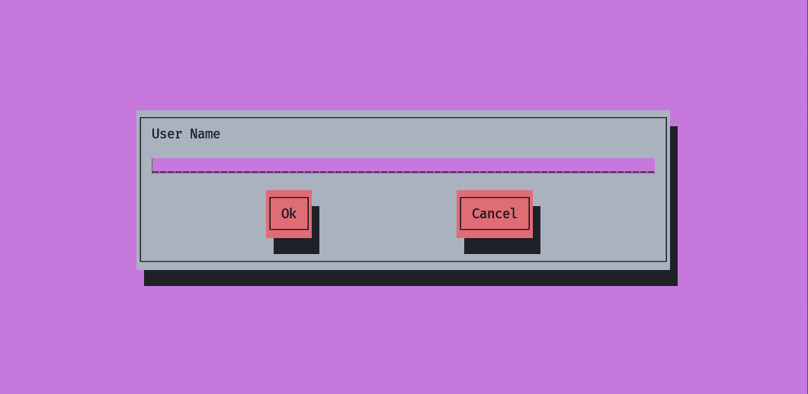
3
Working Process
1. First of all you have to enter your name and password to log in the shop

Slide 7
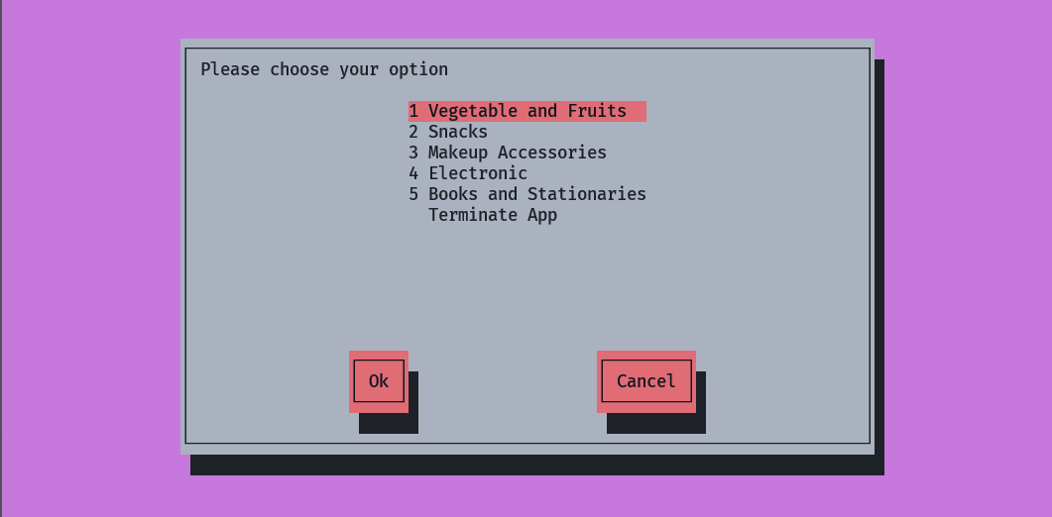
4
Working Process
2. After correctly entering your username and password you will landed In this page where you can select category for your shopping

Slide 8
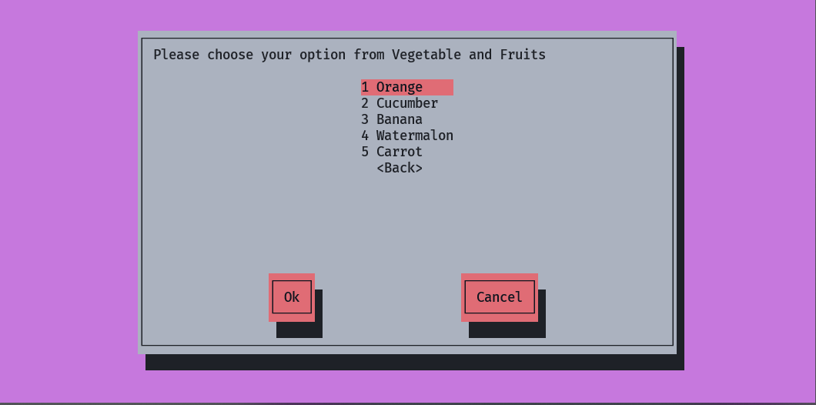
5
Working Process
3. After selecting the category, you have to select the products.

Slide 9

6
Working Process
4. Now you have to provide the quantity of product you need to buy.

Slide 10
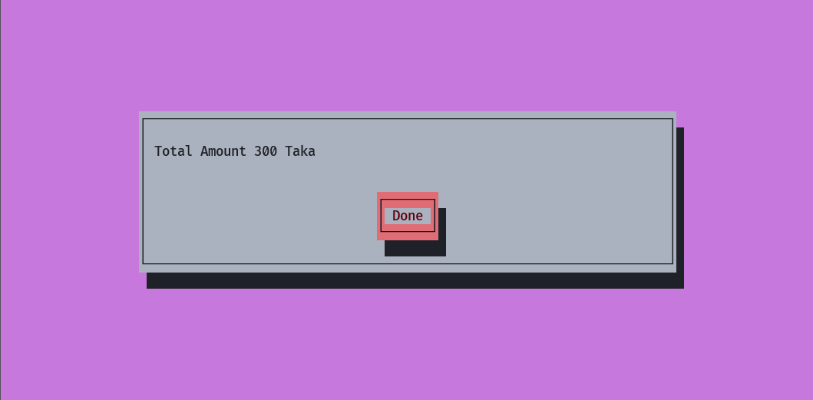
7
Working Process
5. After going through all the previous correctly, you get this page with total amount of price you need to pay and confirm button to proceed. After confirm this step you will go back to the main menu.

Slide 11
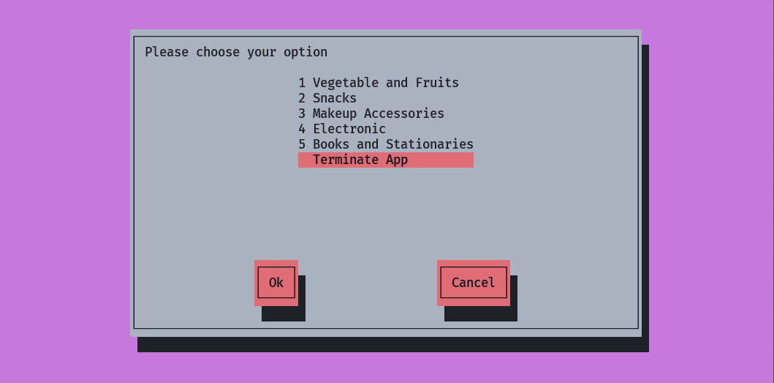
8
Working Process
6. Anytime you can exit the app by choosing this option.

Slide 12
9
Live Demo
Now I am going to show the app and functionally to you. With the permission of our honorable teacher.

Slide 13
10
Future Goal
Implement of online payment System
Add more product category
Add product from other source (e.g. csv)
Proper inventory management
Multilevel user support (e.g, admin, manager, shopper)
More user authentication system

Slide 14
11
Conclusion
The Super Shop Management System implemented using a Bash script provides an efficient and user-friendly way for retail shopkeepers to manage their day-to-day operations. This lightweight solution allows for the easy addition and updating of inventory, processing sales transactions, and generating crucial reports to monitor shop performance.

